Slide 1
HOSPITAL MANAGEMENT SYSTEM

Slide 2
Group Members
MUNEEB ISHAQ 153404
ASIM NOOR 140970
ABDUL BASIT 193227

Slide 3
INTRODUCTION
Hospital
Features
Problem statement
Solution

Slide 4
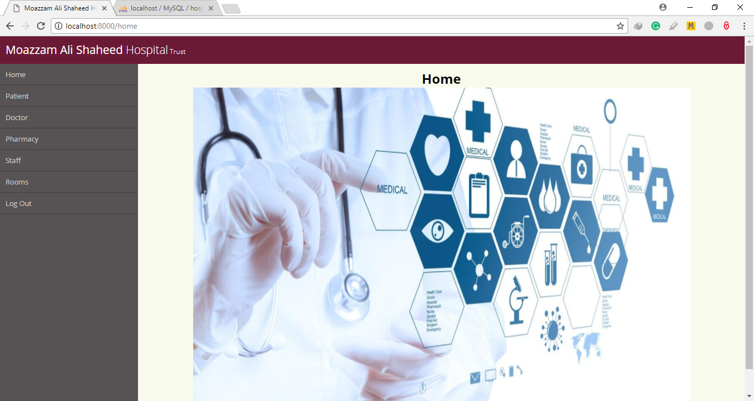
Management system

Slide 5


Slide 6

Any Questions ???

Slide 7


